Slide 1
Routing Algorithm for Cluster Based Wireless Sensor Networks
Presented By:
Bhushan Bhise

Slide 2
Contents
Short introduction about Wireless Sensor Networks (WSN)
Why we need specific protocols in WSN
How exactly these protocols work ( considering example of algorithm for partially connected cluster based sensor networks)

Slide 3
Introduction to WSN
WSN is network of wireless sensor nodes deployed over area of surveillance
The nodes sense the physical data and send it to the Base Station
Base station collects the data and do necessary processing.
Base station can also send commands to actuator at sensor node if required

Slide 4
Need of Energy Efficient Protocols
Size of sensor node is small and hence less space for energy supplying elements.
With less energy available the network is expected to last for several months.
Energy Consumption is considered as umbrella term.
Wireless protocols such as wifi can not be used in WSN because it is energy consuming protocol.

Slide 5
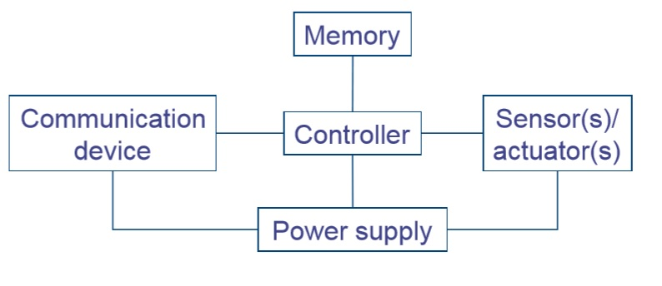
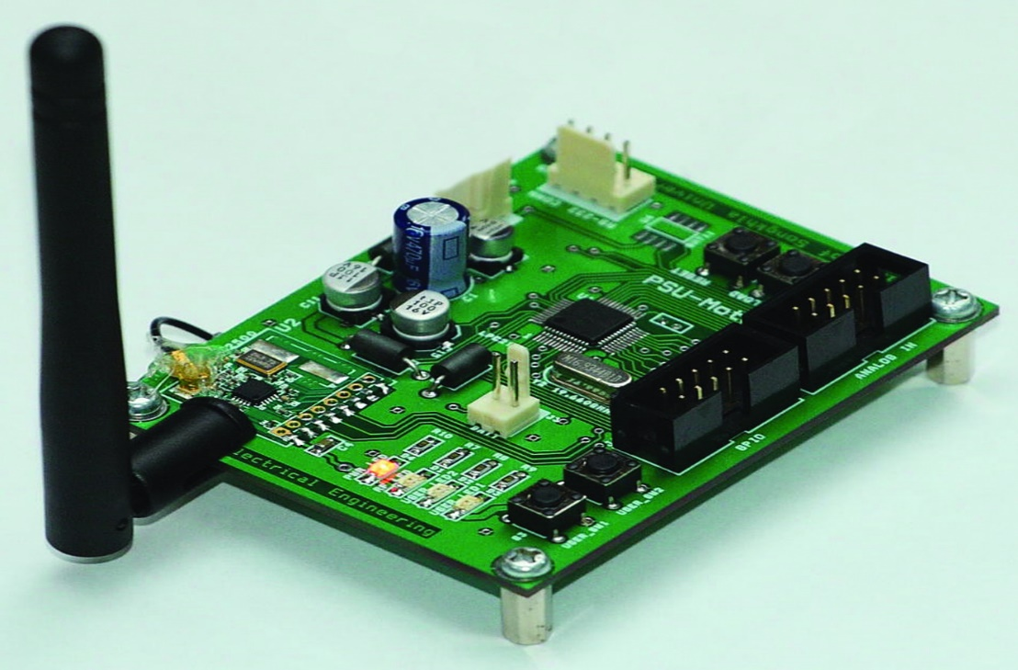
Need of Energy Efficient Protocols
We need to control when to send data and when to receive because of only one trans-receiver.
We need protocols which can control the inter cluster and intra cluster data transmission with energy efficiency.

Slide 6
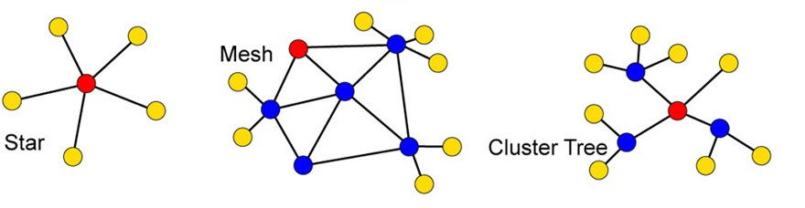
Topologies in WSN
Three main topologies
Cluster Based topologies can reduce the burden at base station
Data aggregation is possible
Only one node in the cluster can be given responsibility to transmit data to base station reducing the energy consumption

Slide 7
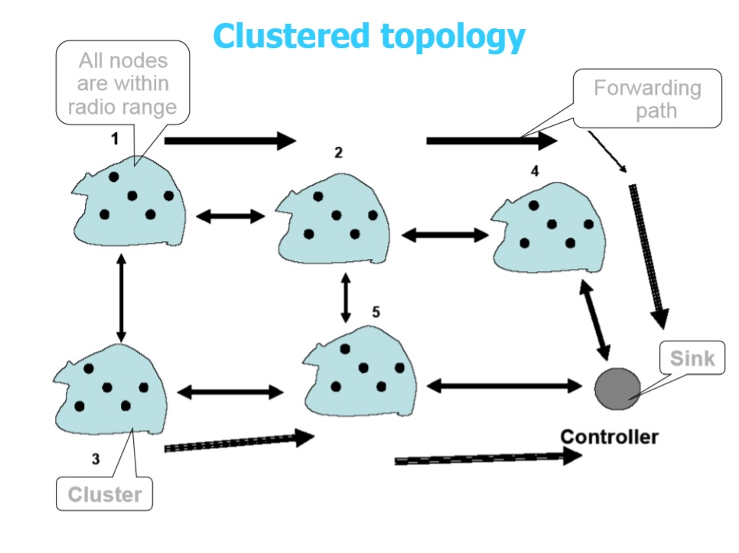

Slide 8
Algorithm for Partially Connected Cluster based Network
Four Phases
Initialization Phase
Contention Phase
Exchange Phase
Termination Phase

Slide 9
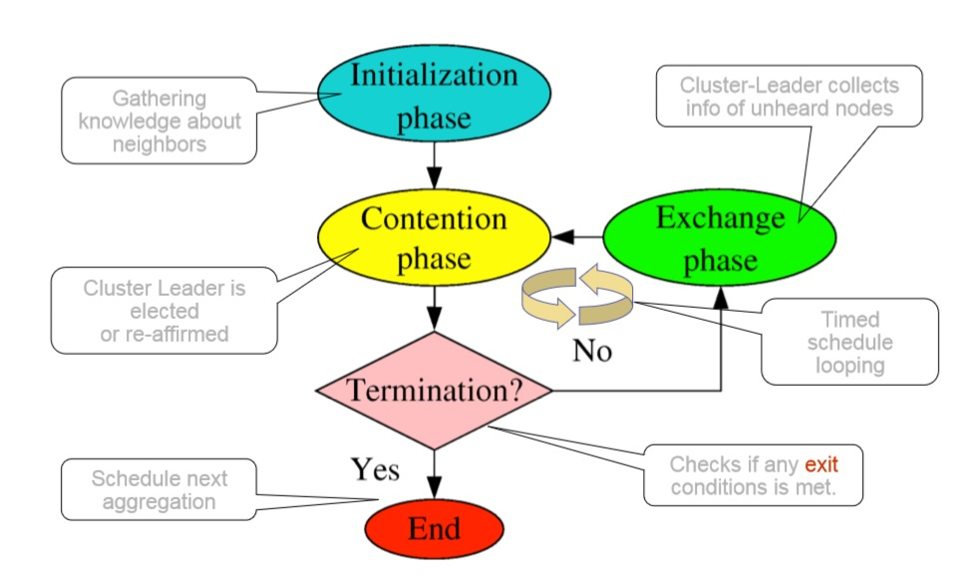

Slide 10
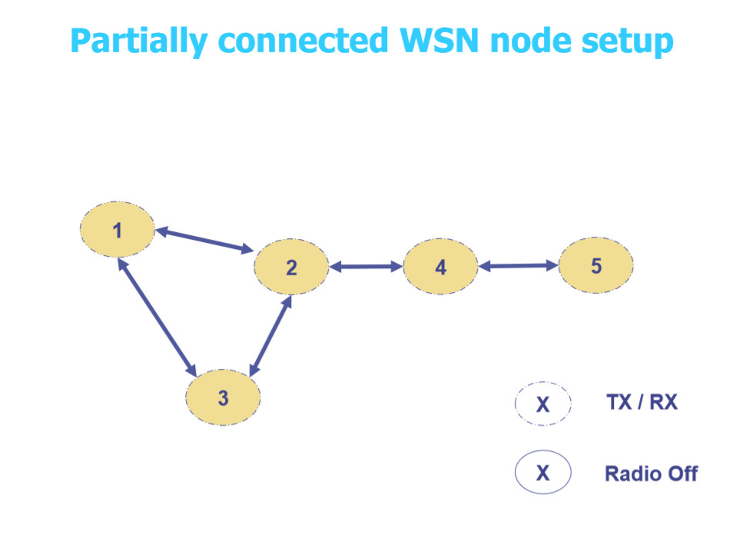
Heard from | Routed Through | Energy Level
1 | empty | 12 J
3 | empty | 12J
4 | empty | 12J

Slide 11
Initialization Phase
All the nodes know their neighbors by sending their information to neighbor
The sent information contains the node id and energy level of the node.
Each node maintains the heard from table which gives information about the neighbor nodes.

Slide 12
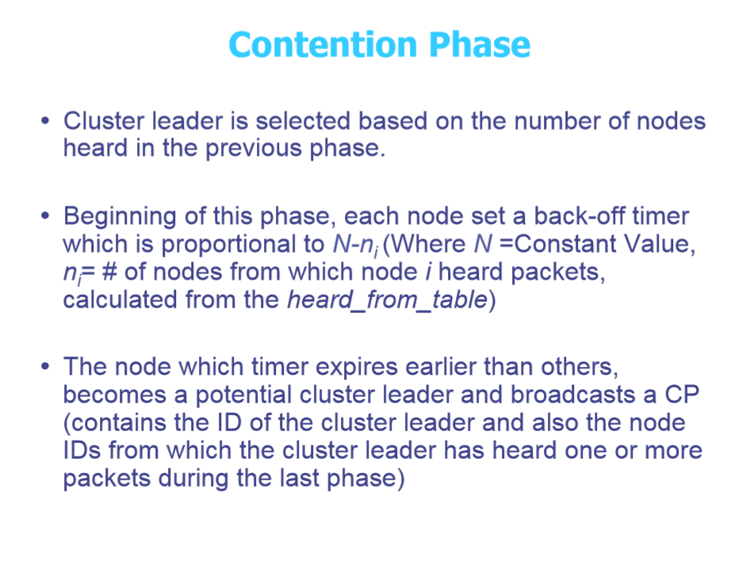

Slide 13
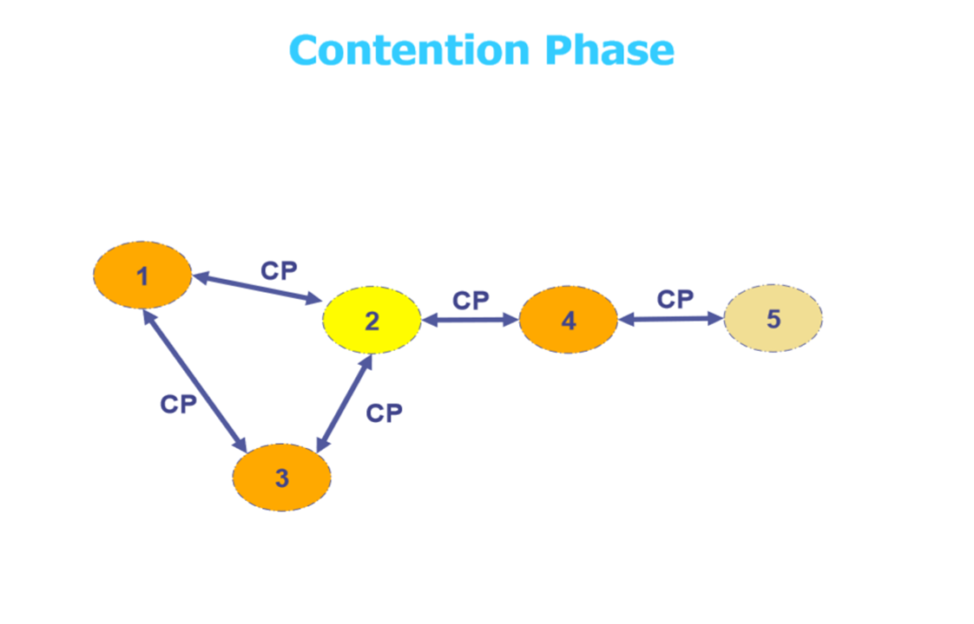


Node number | Number of neighbors
1 | 2
2 | 3
3 | 2
4 | 2
5 | 1

Slide 14
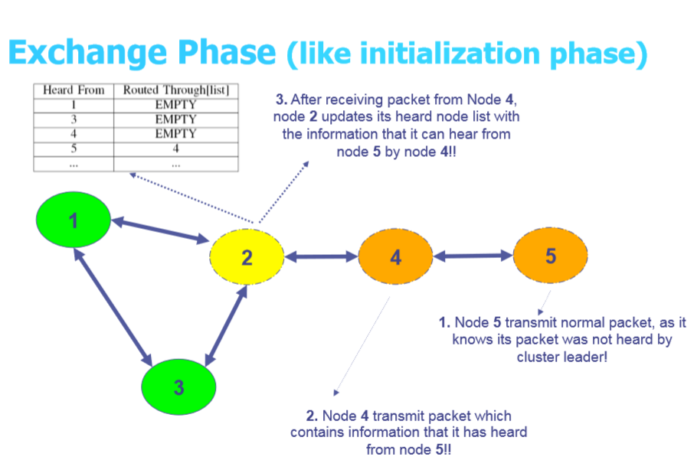

Slide 15
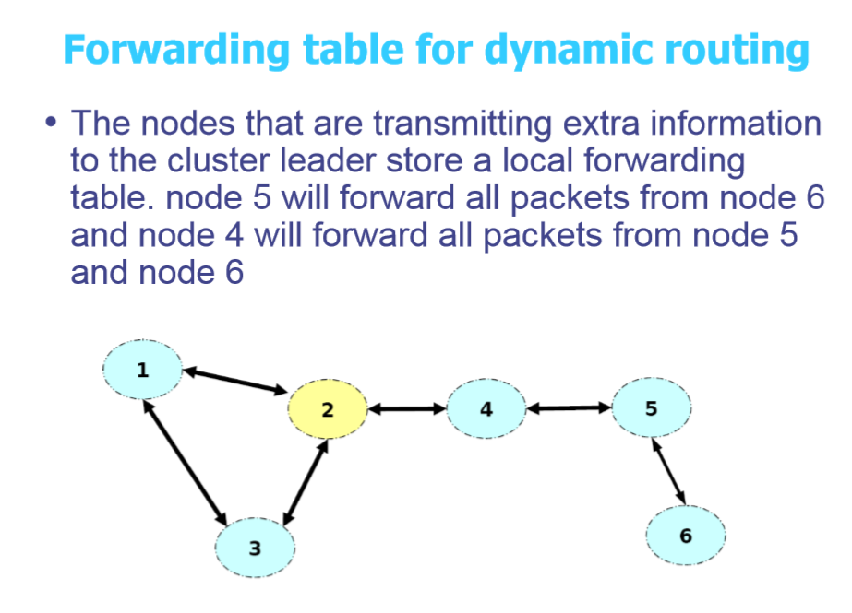

Slide 16
Termination Phase
After exchange phase the cluster leader will have all needed information about the cluster.
It will directly communicate with the base station or with the neighboring node whichever is specified in the protocol.
While selecting cluster leader for next round, the energy consumption of the node to be selected as cluster leader will be considered.

Slide 18
Conclusion
The algorithm effectively select cluster leader which can transmit aggregated data packets to base station
This algorithm increases its efficiency by considering energy level of node to be selected as cluster leader.
Thus Cluster topology can effectively reduce the energy consumption in sensor node increasing lifespan of network.

Slide 19


